Slide 1

The sound of Phonak
Sonic branding
Phonak sonic guidelines May18th, 2022

Slide 2

Contents
Why sonic branding
About the sound of Phonak
- Phonak music- Phonak music
- Phonak voice profile
- Phonak video outro
4. F.A.Qs

Slide 3

Why sonic branding is important for Phonak
Audio is at the heart of everything we do and using the power of music, voice and sound, we can create unique and unforgettable moments and experiences that empower our audience, connecting them to what they truly value.
Great brands engage rationally and emotionally, and we can take our brand to the next level.
These are not only the audible ways in which we want Phonak to be heard, but fundamentally define how we want our audience to feel.

Slide 4
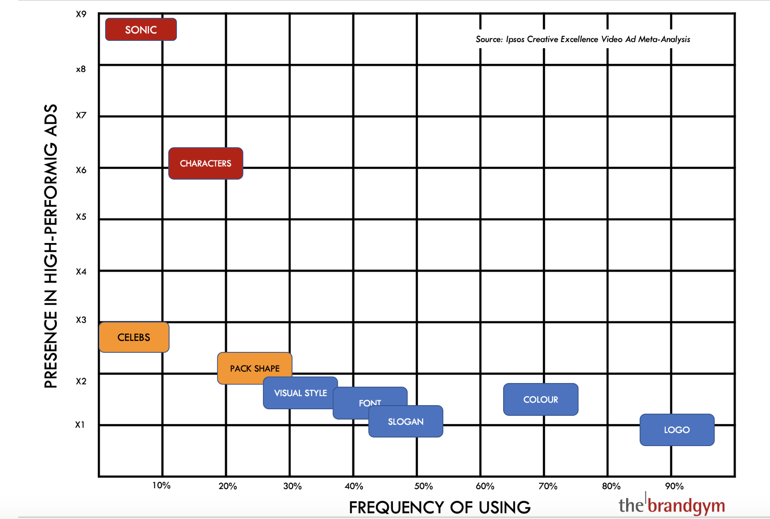
Why sonic branding is important for Phonak
In a study on the impact of branded assets conducted by IPSOS in 2020, results indicated that sonic branding assets were 8.5X more likely to appear on high performing creative - better than any other branded asset in the study.
Presence in high-performing ads
Frequency of using
Source: IPSOS Creative Excellence. Video Ad meta-analysis. Sample 2,015 USA

Slide 5
Why sonic branding is important for Phonak
It builds our brand
By harnessing the power of music, voice and sound, we can make deeper emotional connections with our audience. In time, our sonic identity will become as recognisable as our visual branding.
It separates us from competitors
Phonak needs to stay top-of-mind and distinct from our competitors
It saves money and increases efficiency
We own the Sound of Phonak. With the assets stored in one place, using the the Sound of Phonak will save you time and money.

Slide 6
About the sound of Phonak

Slide 7
How we started
We have worked with sonic branding specialists, Sonicbrand, to explore the music, voices and sounds that will bring to life the philosophies that are at the heart of Phonak and develop the audio elements that will forge our new sonic DNA.
If our brand was a person, what sort of person would we be?
How would we (Phonak) come across? Look? Speak? And what music would we like?
Like our visual and verbal identities, our sonic identity should reflect our values, because they describe the kind of person we want to be.
The role for the “Sound of Phonak” is to dial up the emotional part of our brand, helping audiences take notice and feel more warmly about us.

Slide 8

The sound of Phonak
We know that music plays a key role in our brand experience, and we want the “Sound of Phonak” to be the soundtrack our audience would choose.
Our brand goes beyond brand identity; the sound of Phonak gives us the opportunity to tell our audiences who we are and what we stand for, through music, delivering an impactful and more immersive experience of our brand.

Slide 9
Phonak music – Creative principles
Determined
  Rhythmic instrumentation
  Consistent beat
  Crescendos
  Defined musical structure
Forward-Thinking
  Clean textures
  Contemporary music production
  Unique harmonies
  A combination organic and electronic instruments
Vibrant
Spirited string melodies
Rising bassline
Natural sounds
Vocal textures
Vibrant
Spirited string melodies
Rising bassline
Natural sounds
Vocal textures

Slide 10
Phonak music
We have developed a music strategy to align with the brand for many years to come, a solution that reflects the true emotion of Phonak and its audience.
It also has a series of important characteristics:
The music is owned by the brand, so it becomes a unique and distinct brand asset. From now on, we do not license other people’s music – we use (and if required) make our own.
Our musical theme ‘life is on’ is flexible enough to adapt to any use; long or short – any message. We can be inventive without limits.
Our music is inclusive. We have understood the challenges faced by those with hearing loss and designed a musical identity that allows everyone to enjoy it.

Slide 11

The sound of Phonak – main theme
Phonak main sonic theme
This is our hero sonic theme.
Phonak sonic guidelines
11

Slide 12
The sound of Phonak – main theme
Phonak main sonic theme
This is our hero sonic theme.
Use case:
Main purpose will be to strengthen the brand’s sonic identity and recognition to engage the audience on an emotional level with the brand.
Use this variant if you are in any doubt.
Phonak sonic guidelines
12

Slide 13

The sound of Phonak – variants
‘Ambient’ sonic theme
This subtle version of our sonic logo should be used for low impact and in background settings.
Phonak sonic guidelines
13

Slide 14
The sound of Phonak – variants
‘Ambient’ sonic theme
This subtle version of our sonic logo should be used for low impact and in background settings.
Use case:
- For the final minutes before the “show” starts shall give the audience a welcomed feeling
- background music at exhibition stands (endless sound loop), road shows
- also for sales presentations, media day, call centers, sound systems etc.
Phonak sonic guidelines
14

Slide 15

The sound of Phonak – variants
‘Emotional’ sonic theme
This emotive version of our sonic logo is best to support emotional topics.
Phonak sonic guidelines
15

Slide 16
The sound of Phonak – variants
‘Emotional’ sonic theme
This emotive version of our sonic logo is best to support emotional topics.
Use case:
Testimonials
Real-life stories
Roadshows
Sales presentations
Audiology events
Etc.
Phonak sonic guidelines
16

Slide 17

The sound of Phonak – variants
‘Uplifting’ sonic theme
This version of our sonic logo is best used whenever an uplifting, uptempo version is requested to convey easiness, careless and simplicity.
Phonak sonic guidelines
17

Slide 18
The sound of Phonak – variants
‘Uplifting’ sonic theme
This version of our sonic logo is best used whenever an uplifting, uptempo version is requested to convey easiness, careless and simplicity.
Use case:
“How-to-Movies”
Instructions
Animated illustrations (for Peds), etc.
Phonak sonic guidelines
18

Slide 19
The sound of Phonak – variants
‘Technology’ sonic theme
This modern version of our sonic logo helps emphasize the visionary aspect of our brand personality and the evolutions of hearing technology:
Phonak sonic guidelines
19

Slide 20
The sound of Phonak – variants
‘Technology’ sonic theme
This modern version of our sonic logo helps emphasize the visionary aspect of our brand personality and the evolutions of hearing technology:
Use case:
Visionairy topics
Evolution of hearing technology
Tech-heavy information
Phonak sonic guidelines
20

Slide 21
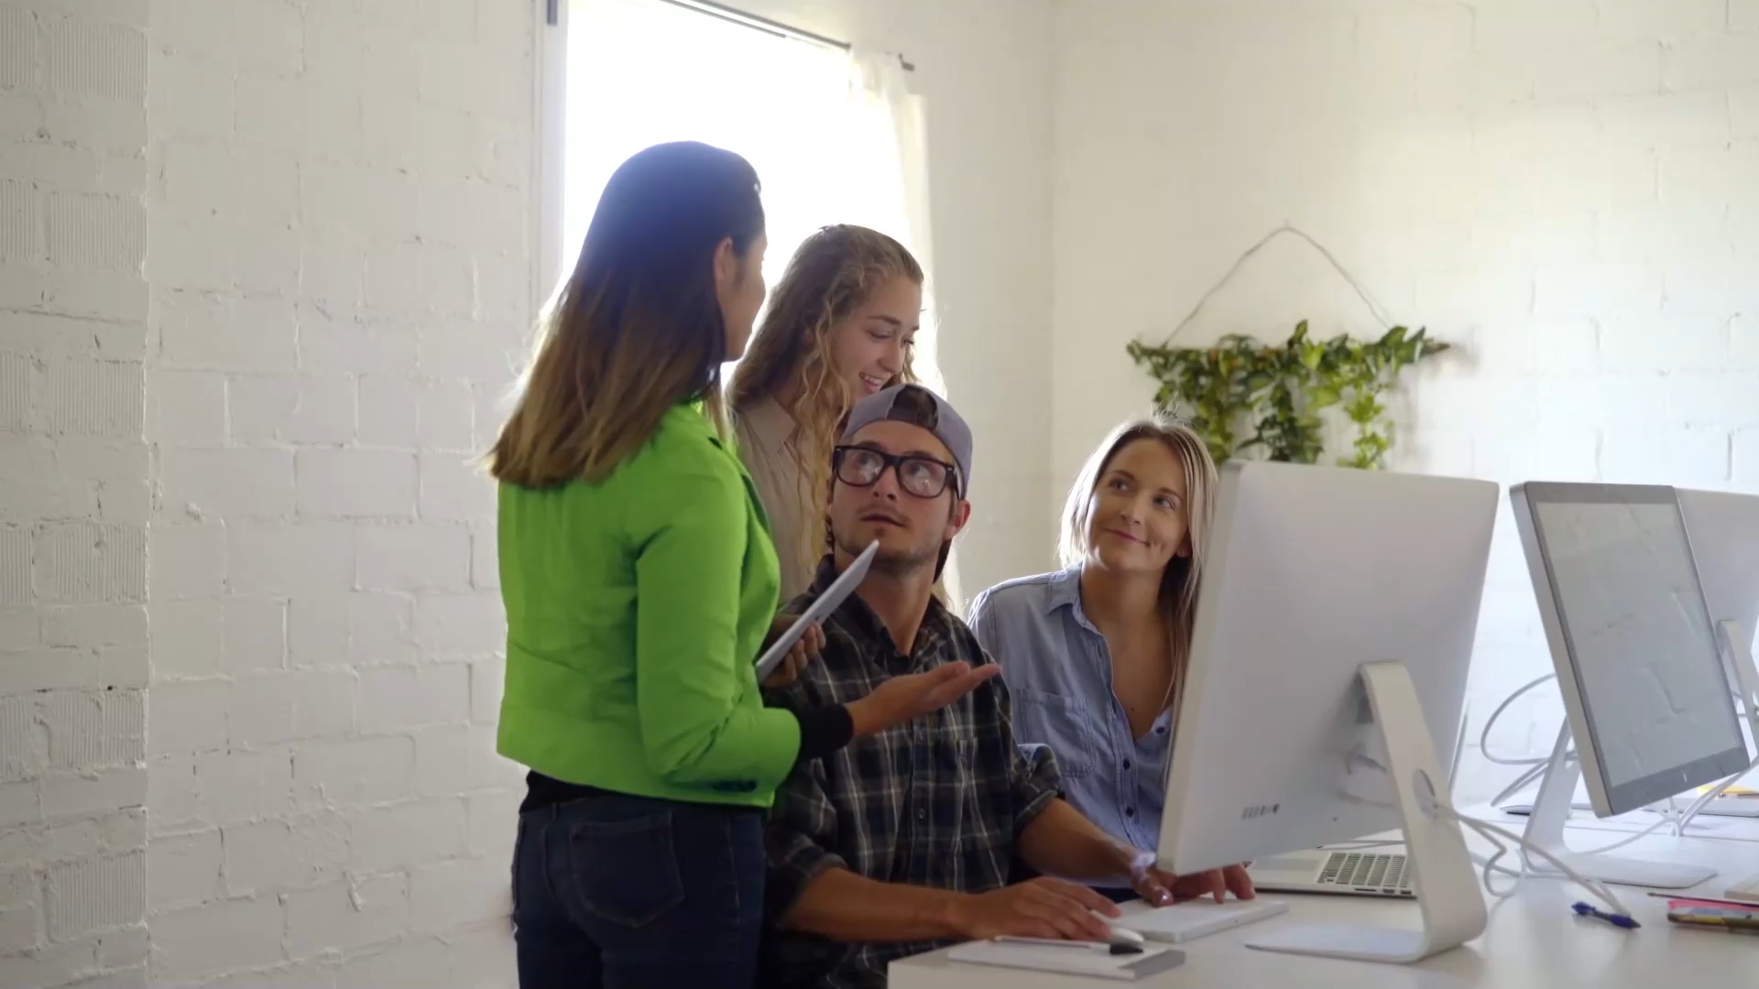
The sound of Phonak – variants
The hook / Video outro
Whenever you create a video that contains regardless of what nature, add the available template with the integrated sonic hook.

Slide 22
Foundational music assets – sonic themes
We have created an initial library of approved sonic themes, and you can choose between these variants depending on the context and the feel required.
The use of the approved ‘Sonic logo’ (alongside our visual brandmark) as a sign off at the end of films is mandatory.
These assets should be used without any alterations or modifications.
New approved versions of the logo will be created in the future.
Requests for changes, or adaptions should be directed to branding@phonak.com.

Slide 23
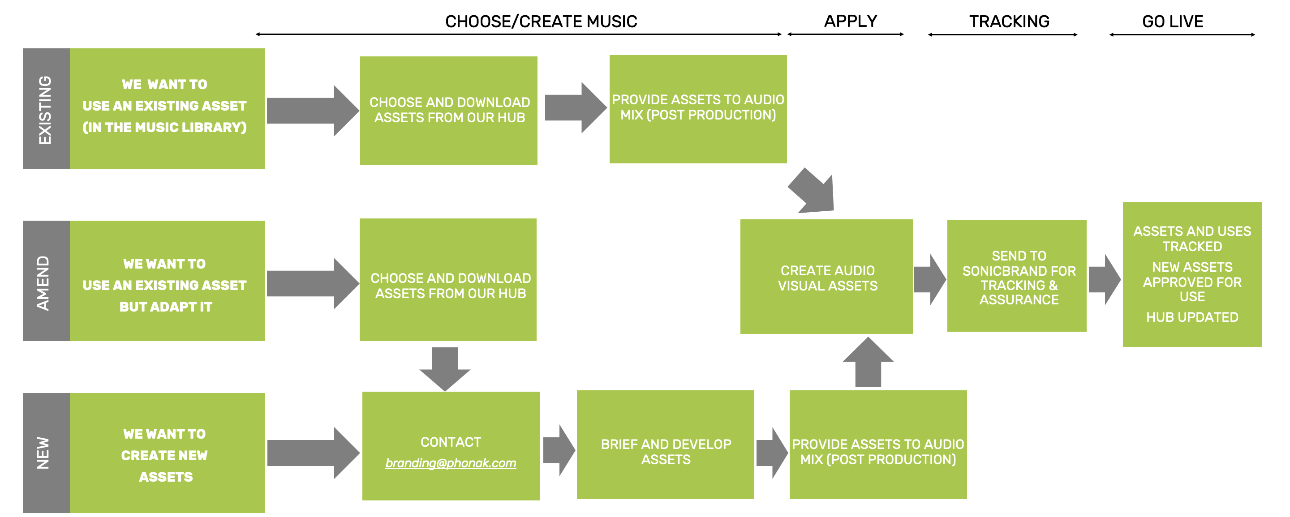
Foundational music assets – sonic themes
For every audio communication, Phonak’s sonic logo and music assets should be considered as mandatory elements. There are three simple ways of working:

Slide 24
The Phonak voice profile

Slide 25
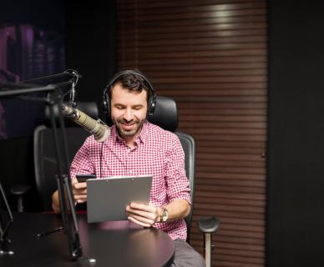
The Phonak voice profile
Voice is a powerful means of communication for Phonak and an important part of the multi-sensory brand experience. This voice profile will act as a guide for how we use the spoken word and engage our audiences beyond the visual.

Slide 26
Phonak voice
This voice guide is built from our brand purpose ‘life is on’ and our inspired by our personality: Determined, Forward Thinking and Vibrant.
Different qualities in a voice can trigger certain emotions in the listener and choosing the right voice will help communicate our message clearly and consistently.
The Phonak voice is designed for all communication channels e.g. launch/campaign movies, online, TVCs, events, trade fairs. Conferences and podcasts.
Our brand and products are driven by audio and our voice can become another consistent, ownable and recognizable asset, helping Phonak to build affinity and even drive sales.

Slide 27
Phonak voice – application examples
Application examples | Phonak brand voice expression
Digital Content/TVCs | Narration, voiceover
Radio | Narration, voiceover, podcasts
Social Content | Narration, voiceover, Presenter/host
Products | Digital human. Voice assistant, IOT
Events/conferences | Presenter/host, digital humans
Apps/websites/software | Narration, guides, commands, voiceovers
Contact center | Receptionists, host, guide (human)
Phonak sonic guidelines
27

Slide 28




Phonak voice – profile
Gender
Age
Accent
Pitch
Male/female
Phonak supports diversity and our voices should reflect this. Choose whichever gender best suits your communication and messaging.
40-55
Our voice should reflect the expertise of our team and products. It should feel mature and assured, but not arrogant. It must also be accessible to a wide range of audiences.
General American English*
Our accent should aim to be neutral, lacking any distinct regional, ethnic, or socio-economic characteristics.
Medium-Low
Those with hearing loss may find it difficult to hear higher frequencies. Lower pitched voices, (especially female) may be more easily understood by our end users.
Applicable for English language – adapt accordingly for other languages and use “accent free” voices
Phonak sonic guidelines
28

Slide 29
Phonak voice – performance guidelines
Once you have chosen a voice, it will be important to offer some guidance on performance. Vocal delivery will help consistently reinforce our profile. Whilst performance style may vary dependent on the communication narrative, touchpoint or intended audience, the following directions should be applied to everything we do.
Characteristic | Description | What we want | What we don’t want
Volume | How loud or soft is a speaker’s volume. | Medium | We don’t want anything too quiet, but equally no shouting and overexertion in the voice.
Clarity | How the chosen words are articulated. | Clear and crisp | As a brand that delivers high quality audio experiences and communicates to those with hearing loss, it’s important our voice doesn’t sound muffled or hoarse.
Pace | The speed that voice is spoken at. | Steady | Even if we have a lot of information to convey, we never want to rush!
Intonation | How the chosen words are said. | Musical/variation in tone | A flat or monotone voice will quickly become tiresome, especially when we are sharing product specs.
These rules also apply to any other language than English, try to adapt them accordingly to local languages.
Phonak sonic guidelines
29

Slide 30

Phonak voice – examples
The below are examples showcase how to deliver voiceovers that best suit our brand.
Gender | What we want | Description
Male 1 (more mature) |  | This mature but friendly voice uses lots of intonation, adding personality to our messaging. The clear and crisp read is easy to understand and delivered with confidence.
Male 2 (younger) |  | Though younger, this voice communicates our messaging assertively. A warm feeling helps deliver heightened emotion.
Female 1 |  | A lower pitch female voice is more easily heard by those with hearing loss. A moderate pace makes it easy to follow and lots of intonation helps maintain listener interest.
If you would like to use any of these voiceover artists, please contact branding@phonak.com
Gender | What we don’t want | Description
Male |  | This read is fast and monotonous, making it difficult to understand. It lacks the personality that’s crucial to bring our brand and stories to life.
Male |  | This read is too loud and extroverted. It lacks the precision, and expertise that supports our brand and product messaging.
Female |  | This read is monotonous and robotic. The listener would soon lose interest in the message being communicated.
Phonak sonic guidelines
30

Slide 31
FAQs

Slide 32
FAQs
Does Phonak own these music tracks and sounds?
Yes. Phonak owns the rights to all music and sound arrangements and versions in the “Sound of Phonak Hub”. Phonak will only own new versions (assets) once the necessary contracts have been signed between us and the arrangers/music producers/sound designers; so it is vital that the licenses are properly completed.
Is there anything to pay to use an approved asset from the Sound of Phonak Hub?
No. These are free but we will need to track the use. Sonicbrand are engaged to manage this process.
What if I would like to use a different music track or sound for my communication/
experience?
Some exceptions may be needed but our first option is always to use an existing track or create a new adaptation of the Sound of Phonak.
Where can I download the assets?
They will be available on the brand platform, end of May
For all tools as of Lumity S3/2022
Send us an email (branding@phonak.com) if you need them earlier.
Phonak sonic guidelines
32

Slide 33
Together, we change lives

